Slide 1
Inter-Process Communication ( 4 ).

Slide 2
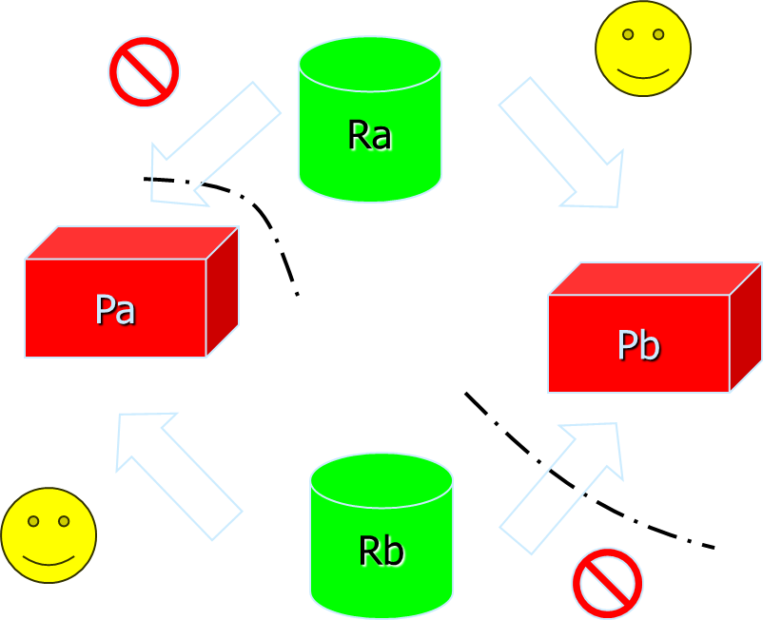
Producer and consumer.
Producer
Consumer
down(mutex);
down (#free);
produce(&ice_cream);
up(mutex);
up(#full);
down(#full);
down(mutex);
eat(&ice_cream);
up(mutex);
up(#free);
Wait state

Slide 3
Deadlock.

Slide 4
Definition
A set of processes are deadlocked if they all wait on an event that only one of these processes can induce.
An external actor’s intervention is required:
a resource manager
a human operator
the operating system
Local program logic is right, deadlock occurs due to the collective action of a group of processes-> it’s a global condition.
Notes:
Resource manager: gestion des graphes d’état,
Human operator: de CTRL/ALT/DEL à gestion chirurgicale: trouver « LE » processus qui bloque et le tuer

Slide 5

Safe and unsafe state.
Process B
Printer
Plotter
Printer
Process A
Plotter

Slide 6
Deadlock representation.
P
P
Process P
Holds Resource R
Process P is
waiting for resource R
R
R

Slide 7
Deadlock representation
resource allocation graph
A
B
C
R
S
T

Slide 8
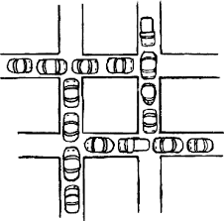
4 conditions for deadlock to occur
Mutual exclusion:
exclusive use of a resource by a process
Hold and wait:
process holds a resource and requests a new one
Circular wait:
see previous slide
No preemption:
resource released by explicit action of process

Slide 9
4 strategies.
Ignorance:
means manual intervention.
Prevention:
by a attacking one of the 4 conditions
Avoidance:
by a conservative resource allocation strategy
Detection and recovery:
detect deadlock condition and recover

Slide 10
Deadlock prevention: Hold and wait
Allocates all resources at start time.
Sub-optimal all resources even used for a short period are allocated during the whole process life.
Releases acquired resource if a new one is requested.
Sub-optimal, all allocated resources are released and then allocated -> overhead.
Notes:
STRATEGIE 2: PREVENTION = s’attaquer aux 4 conditions pour un deadlock
Condition 1: Mutual Exclusion
Shared resources such as read-only files do not lead to deadlocks.
Unfortunately some resources, such as printers and tape drives, require exclusive access by a single process.
Condition 2: Hold and Wait

Slide 11
Deadlock prevention: Circular wait.
Resource allocator will prevent the creation of a circular wait.
Impose an allocation order is the best strategy
Notes:
STRATEGIE 2: PREVENTION - Condition 3

Slide 12
Deadlock prevention: Preemption.
If resource are unavailable for a process to continue, resource allocation is backed-out.
May cause a live lock, means each allocation cause a ‘preemption’,
or starvation: a process doesn’t progress
Resource manager is constantly backing-out allocation request
starvation
livelock
Notes:
STRATEGIE 2: PREVENTION - Condition 4

Slide 13
Deadlock avoidance.
Banker’s algorithm.
Has
Max
Has
Max
Has
Max
A
0
6
A
1
6
A
1
6
B
0
5
B
1
5
B
2
5
C
0
4
C
2
4
C
2
4
D
0
7
D
4
7
D
4
7
Free : 10
Free : 2
Free : 1

Slide 14
Deadlock avoidance.
Banker’s algorithm.
Has
Max
Has
Max
Has
Max
A
0
6
A
1
6
A
1
6
B
0
5
B
1
5
B
1
5
C
0
4
C
2
4
C
4
4
D
0
7
D
4
7
D
4
7
Free : 10
Free : 2
Free : 0
Notes:
Ici, on a donné les ressources à C → OK

Slide 15
Deadlock avoidance.
Banker’s algorithm multi resource
Plotter
Cd Rom
Plotter
Cd Rom
Tape
Printer
Tape
Printer
A
3
0
1
1
A
1
1
0
0
E=(6342)
P=(5322)
A=(1020)
B
0
1
0
0
B
0
1
1
2
C
1
1
1
0
C
3
1
0
0
D
1
1
0
1
D
0
0
1
0
E
0
0
0
0
E
2
1
1
0
Resources assigned
Resources still needed
Notes:
E = vecteur des ressources du système: 6 tapes, 3 plotters, 4 printers, 2 CD ROM
P = vecteur des ressources allouées
A = vecteur des ressources disponibles

Slide 16
Detection and recovery
At regular interval, resource manager scans the graph to detect circular condition.
Scan logic is:
start from any point
follow all arcs from that point
If double entry in the list => deadlock
Resource manager decides on a victim
kills one chosen process
back-out all its changes

Slide 17
Transaction atomicity.
All changes made by the transaction are confirmed by a checkpoint or commit point.
No commit point means no change:
as if the transaction was never executed.
Records changed by the transaction are locked till commit point
In case of deadlock, if the resource managers kills the transaction, changes are backed-out:
deadlock on roll-back is impossible.

Slide 18
Back-out / Rollback.
Based on a write ahead logging:
every database change is recorded in a logging
Different types of logging records:
REDO type, base for update replay; contains “after” image.
UNDO type, base for update back-out; contains “before” image.
Depends on operation performed:
Delete= Undo record only, Insert= Redo record,..

Slide 19
IMS/TP and DB.
TP is the transaction monitor:
manages the interaction with users, processes transactions.
DB is the database manager:
manages databases accesses and updates.
Victim choice:
On-line transaction: light and easy to requeue
Batch: heavy and operator intervention for resubmit.
Notes:
IMS = Information Management System
TP = Transaction Processing

